Slide 1

Next
Steps
For Navigating Your
Job Transition

Slide 2
Welcome
Ron Johnson
Illinois Department of Commerce & Economic Opportunity
Susi Pihera
  DuPage County Workforce Development Division
Scott Miller
  U.S. DOL, Employee Benefits Security Administration
Mary Garcia
  Illinois Department of Employment Security

Slide 3

Our goal is to help you get back to work!
Workforce Innovation & Opportunity Act
“WIOA”
WIOA Services are FREE to you due to the workforce reduction at
.
  Federally funded, paid for through your tax dollars.
  You can access services anywhere in the United States
Westmont, Illinois

Slide 4
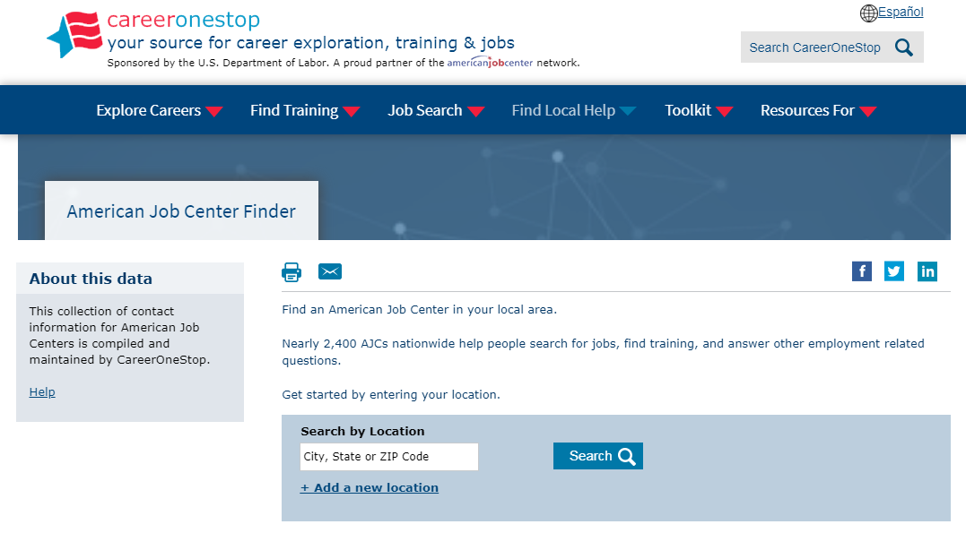
Find an American Job Center anywhere in the U.S. www.careeronestop.org

Slide 5
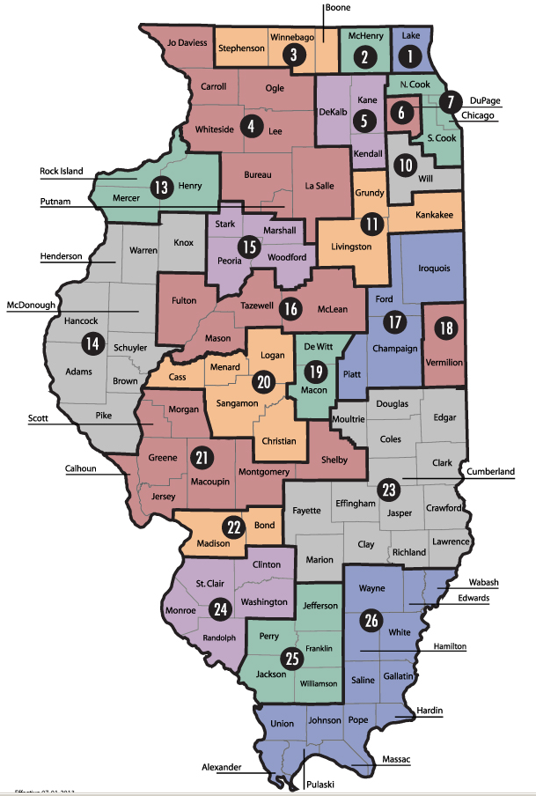

You have customer choice on where to access services
Go to the workNet Center closer to your home
OR
2525 Cabot Drive, 3rd Floor Lisle, IL 60532
www.worknetdupage.org

Slide 6

From entry to executive levels we help people get back to work.
Discover the array of services we offer!
Partner agencies
DuPage County Workforce Development Division
Illinois Department of Employment Security (IDES)
College of DuPage (COD)
Illinois Department of Human Services (DHS) & Division of Rehabilitation Services (DRS)

Slide 7

Don’t do what others do…
Top Mistakes 90% of Job Seekers Make
1. Rely on 1 method in job search; submitting online applications and waiting for an employer’s response.
Less than 20% of job seekers are hired as unknown applicants
(applications received online).
2. Neglect their networks
80% of job seekers hired are known candidates.
Identify your network circle and connect with people to learn about new
opportunities.
3. Forget to customize resume for the specific job posting
One must customize their resume for keyword matches
Show achievements that are relevant to the job posting

Slide 8

Don’t do what others do…
Top Mistakes 90% of Job Seekers Make
4. Fail to research companies before job interviews
Research the company! Ask informative questions & shows desire and interest in the job.
5. Let the employers drive the job search.
Be proactive seeking new opportunities which may lead to multiple job offers.
Do not stop actively looking for work until you started a new job.
6. Begin job hunting without an understanding of skills, strengths, accomplishments and value in the job market.
Identify your:
Skills & strengths
Functional/transferable skills
Achievements & accomplishments
Know your salary & benefit requirements

Slide 9


game has evolved!
Self-assessment a Resume a Interview
= Job Offer
Learn how to play the game!
Let’s talk how can help you!

Slide 10

Career Services - GROUP WORKSHOPS
Learn how to effectively showcase why you are the ideal candidate!
Self Assessment:
  Identify your strengths, skills & accomplishments
Resumes:
  Resumes for applicant tracking systems
  Achievement/Accomplishment Based Resumes
Interviewing:
  Learn what employers are looking for in the interview
  Developing answers for behavioral interviews
  What you should ask during an interview
Networking:
  Learn how to use LinkedIn to uncover company contacts
  Learn how to identify and expand your networking circle
  Discover new networking strategies

Slide 11
Career Services - ONE-ON-ONE ASSISTANCE
Individual Career Coaching
Resume Optimization (writing)
Interviewing Practice
Job Leads
On the Job Training

Slide 12




ADDITIONAL RESOURCES
These resources are FREE to all job seekers
Hiring Events
Job Club
Resource Room
  Free printing and fax
  Computers with internet
Get job search tips, updates and info on social media:

Slide 13

Fri, April 10, 2020
9:00 AM – 9:30 AM
Registration limited
Register at:
Opportunity in the Midst of Chaos
Opportunity in the Midst of Chaos
This time may be an opportunity to refocus your priorities and reframe your thinking about your job search. The workshop covers:
• Best practices for creating structure with a focus on what you can do now during the coronavirus pandemic and social distancing
• Job search and workplace changes
• How to identify career guideposts
• Where to find opportunities and resources to affect positive change.
Discover how life-long learning, opportunities for certifications, micro-degrees, degrees, and licensure can bring focus and benefit to your career.

Slide 14
Are YOUR Skills current?
Explore a career upgrade!

Slide 15


Employees
You may be eligible for up to $10,000 in WIOA funding for school:
Upgrade your skills and/or
Get a professional certification
Grant pays for tuition, books, fees, equipment
Receive unemployment benefits while going to school**
  *Training grant approval is based on your need & suitability.
  **Assuming you are eligible, the maximum length of regular state-funded unemployment insurance in Illinois is 26 weeks. Training does not extend benefits.

Slide 16

IT Training Opportunities
Certified Information Systems Security Professional (CISSP), CompTIA A+, Network+ and Security Certifications; Cisco Certified Networking Technician (CCENT); Cisco Certified Network Associate or Professional (CCNA/CCNP); Microsoft Certified Solutions Associate (MCSA) or Expert (MCSE); AWS Certified Cloud Practitioner and Security.
IT Management and Business Analysis:
Project Management Professional (PMP); PMI Agile Certified Practitioner (PMI-ACP), or Lean Six Sigma Certified ScrumMaster (CSM), Certified Business Analysis Professional (CBAP), Big Data, Certified Cloud Security Professional (CCSP).
Programming, developer, and e-commerce roles:
Java, .Net, Agile, Software Testing & Quality Assurance.

Slide 17
Resources for laid off workers
WIOA approved training programs & providers
Other job seeker resources
Visit Illinoisworknet.com to view:

Slide 18

Get Started TODAY!
Email Spihera@worknetdupage.org to connect with a career counselor!

Slide 19


Let’s Stay Connected!
Email me at spihera@worknetdupage.org
Include:
Your Name
Company (layoff event company)
Personal email
Phone
Home address
Job title

Slide 20

U.S. Department of Labor
Employee Benefits Security Administration
Retirement & Health Care Coverage answers for dislocated workers
Visit us at www.dol.gov/agencies/ebsa
Call us at (866) 444-3272
Contact us electronically at www.askebsa.dol.gov

Slide 21

COBRA
Allows you to continue on your former employer’s group health plan for up to 18 months following a job loss
  Up to 29 months if you (or your beneficiary) are deemed disabled by SSA
You pay the full cost of the insurance plus a 2% administration fee
There is a formal election process to get onto COBRA
  The election notice must be sent to you within 44 days of coverage loss
  You have 60 days to elect the COBRA
  You have 45 days to make your first payment from the date of election
COBRA coverage is retroactive to date coverage was terminated
  Outstanding claims and out of pocket expenses will be paid or reimbursed

Slide 22
HIPAA Special Enrollment
Allows enrollment in a spouse’s employer’s plan (or a parent’s employer’s plan if you are under age 26) when you lose health coverage based upon a job loss
Your spouse (or parent) must request special enrollment from his or her employer’s plan within 30 days of losing coverage
Coverage becomes effective the first day of the following month
HIPAA does not provide a special enrollment right when an employer stops paying towards COBRA based upon a severance agreement

Slide 23

Affordable Care Act (ACA)
Health Insurance Marketplace
You can enroll in the marketplace up to 60 days before your insurance ends or within 60 days after your insurance ends
  Unlike COBRA, the coverage is not retroactive
  Enroll by the 15th of the month for the coverage to begin the 1st of the following month
There are multiple coverage options available to you
  The marketplace will also determine whether you qualify for Medicaid
The marketplace may allow enrollment when an employer stops paying towards COBRA based upon a severance agreement

Slide 24

Affordable Care Act (ACA)
Health Insurance Marketplace
GET COVERED ILLINOIS - official health marketplace for Illinois
(866) 311-1119 • getcoveredillinois.gov
ENROLL DUPAGE - DUPAGE COUNTY HEALTH DEPT.
Robin Lavender, ACA Navigator
630-221-7049
robin.lavender@dupagehealth.org
Please call (800) 318-2596 or visit www.healthcare.gov
if you do not live in Illinois

Slide 25

What options do I have regarding my retirement benefits?
401(k) Plan
Take a distribution
  There is 20% automatic tax withholding and a 10% penalty if you are younger than 59 ½
  A distribution may also affect your unemployment benefits
Roll the account into another employer plan or your own IRA
  There are no tax consequences with a rollover
Leave the account with your former employer
  Make sure the plan has your current mailing address and email address
  You should receive information from the plan annually

Slide 26

Illinois Dept. of Employment Security
How to file & certify for unemployment insurance benefits
Information on Illinois JobLink
www.ides.illinois.gov
IDES Call Center – 800-244-5631

Slide 27
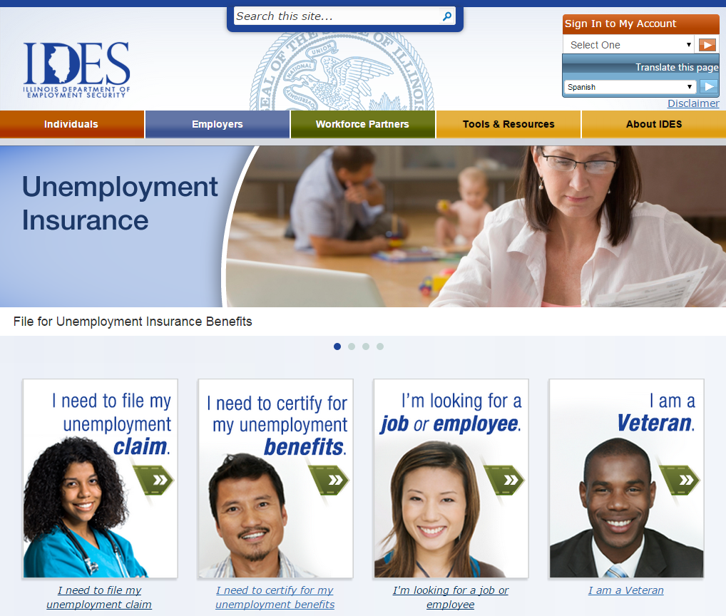

How to file your claim on-line
Important! Verify web address: www.IDES.Illinois.gov

Slide 28
Online Filing Schedule
In order to process the extremely high volume of unemployment benefit claims due to COVID-19, IDES has implemented the following schedule for those filing claims online:
Online Filing Schedule:
Last names beginning with letters A-M will be Sundays, Tuesdays, or Thursdays.
Last names beginning with letters N-Z will be Mondays, Wednesday, Fridays.
Saturdays will be available for anyone to accommodate those who could not file during their allotted window.
The day or time of day in which a claim is filed will not impact whether you receive benefits or your benefit amount. Additionally, claims will be back-dated to reflect the date in which a claimant was laid-off or let go from their job due to COVID-19.
Note: The days in which you can file a claim may be different from the days in which you are asked to certify.

Slide 29
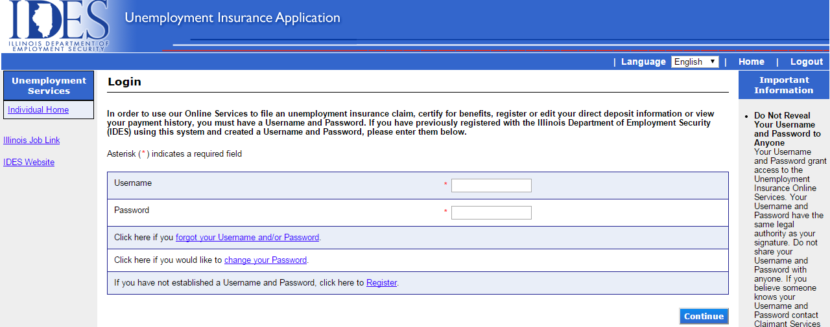
First Step - Log In
Previously registered; enter Username & password.
First time registration click register.

Slide 30
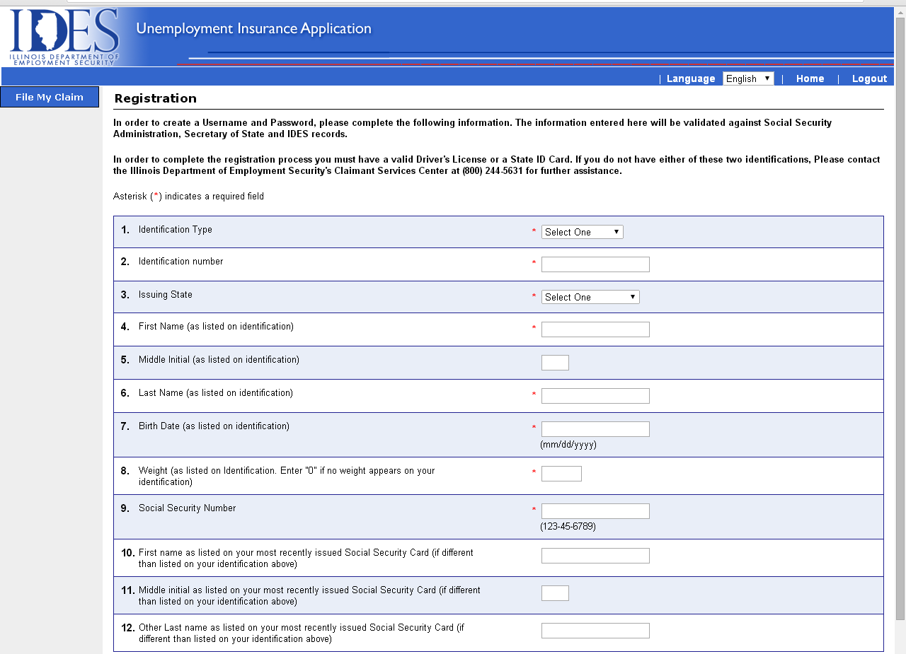
Verifying your identity
Driver’s License or State ID
Enter weight as listed on ID

Slide 31
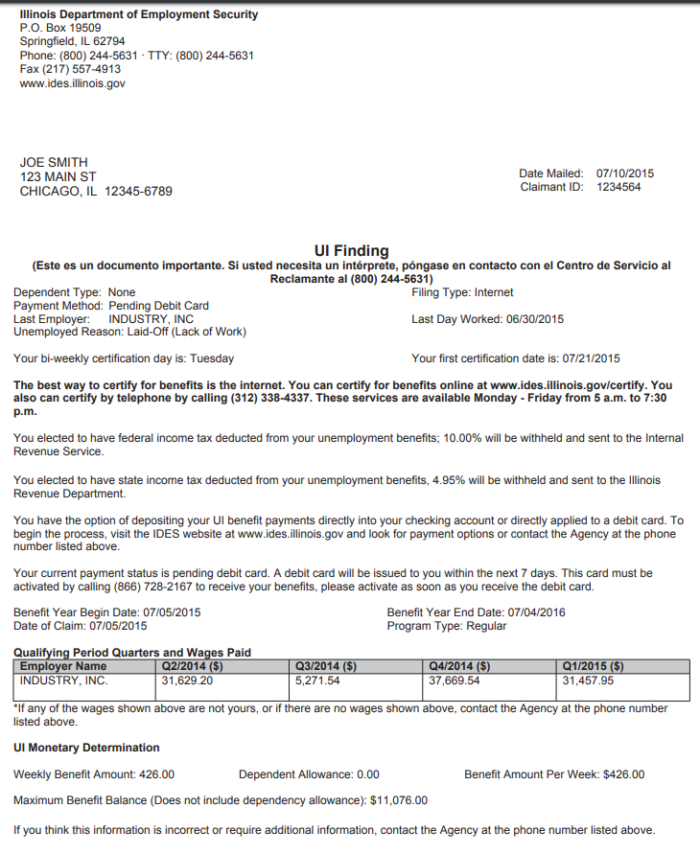
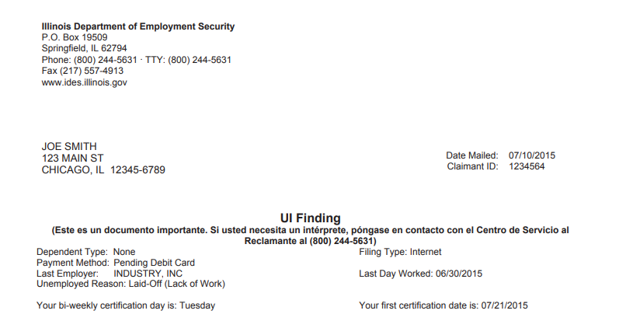
Illinois Dept. of Employment Security
UI Findings Letter should arrive U.S. Mail 5 – 7 days after you filed your claim
See page 1 of “I filed my claim, what happens now” brochure

Slide 32
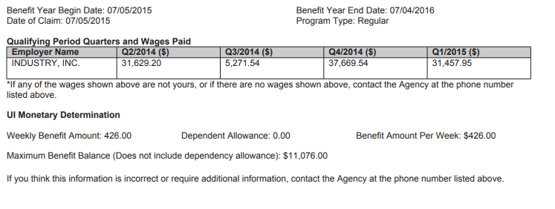
UI Findings Letter
2020 MAXIMUM WEEKLY BENEFIT AMOUNTS:
$484.00 Single no dependents
$577.00 Non-working spouse as dependent
$669.00 With one or more child under 18
*As of January 5, 2020, these amounts are subject to change

Slide 33

Important Information on YOUR Findings Letter

Slide 34

To receive UI benefits, you must certify
Certify every 2 weeks
Review and prepare the answers before you certify to ensure quick, accurate certification.
You must be:
Able
Available
Actively searching for work to receive unemployment insurance benefits.

Slide 35
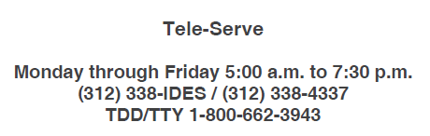
Certify via the telephone
Review and prepare answers before you certify to ensure quick, accurate certification.
Pg. 3 of “I filed my claim, what happens now” brochure.
6. Are you receiving or have you applied for primary Social Security
benefits?
7. Other than Social Security, are you receiving or have you
applied fora retirement or disability pension?
• If yes, has the amount changed?
8. Did you attend school or receive training?
• If yes, did you attend all scheduled training courses?
• If no, enter the number of days that you did not attend class.
9. Do you have a current workers’ compensation claim or do you expect
to receive workers’ compensation for a temporary disability?
10. Has your phone number changed?
• If yes, enter your new ten-digit telephone number.
11. Has your mailing address changed?
1. Have you received or will you receive holiday pay during the period
of Sunday through Saturday (week 1 beginning date through week 2
ending date)?
• If yes, enter the gross amount of your holiday pay (before
deductions) for each week.
2. Did you work during the period of Sunday (week 1 beginning date)
through Saturday (week 2 ending date)?
• If yes, enter the total amount of earnings (before deductions)
for each week.
3. Has your dependency status changed during this certification period?
4. Were you able and available to work each day during your normal
work week?
• If no, enter the number of days you were unavailable for work
in each of the weeks.
5. Did you actively look for work for the week of Sunday (week 1
beginning date) through Saturday (week 2 ending date)?

Slide 36
How earnings affect your UI benefits?
If you earn less than half of your weekly benefit amount (WBA), you will receive your full WBA
If you earn more than half of your WBA, there will be a dollar-for-dollar deduction from your WBA
If you earn an amount equal to or more than your WBA, your claim will be closed
For example: Your WBA is $400
 | Earn less | Earn more | Earn 100%
 | than 50% | than 50% | or more
WBA | $400 | $400 | $400
Earnings | $190 | $210 | $400+
WBA | $400 | **$390 | $0
**dollar-for-dollar deduction from your WBA

Slide 37
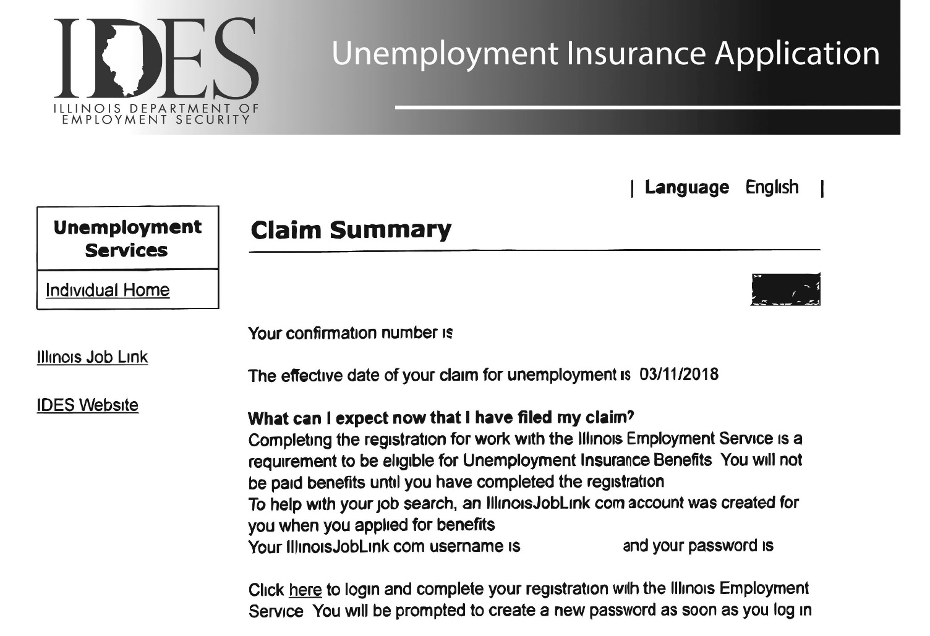
Important
Print/save YOUR
Claim Summary page
Claim Summary Page

Slide 38

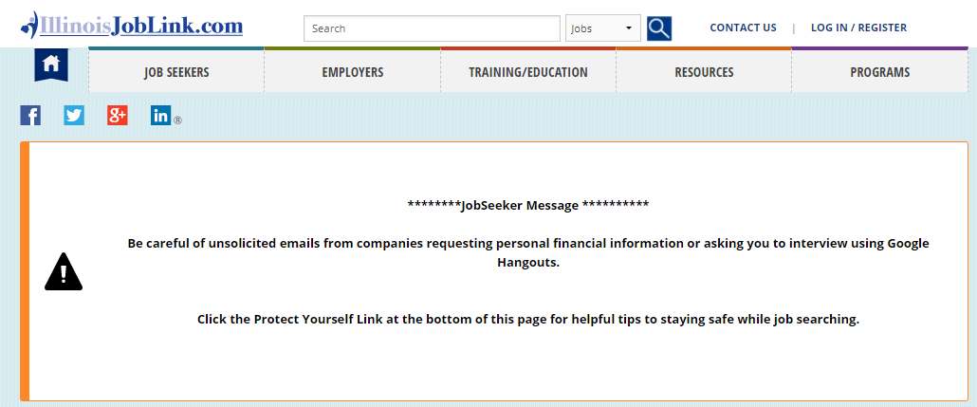
Employment Service Requirement
LOG IN/REGISTER
www.IllinoisJobLink.com

Slide 39
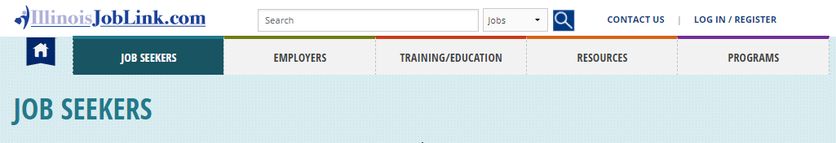
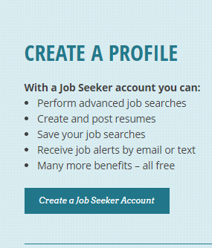
Illinois JobLink
To complete your required registration for Illinois JobLink, start by creating a profile.

Slide 40
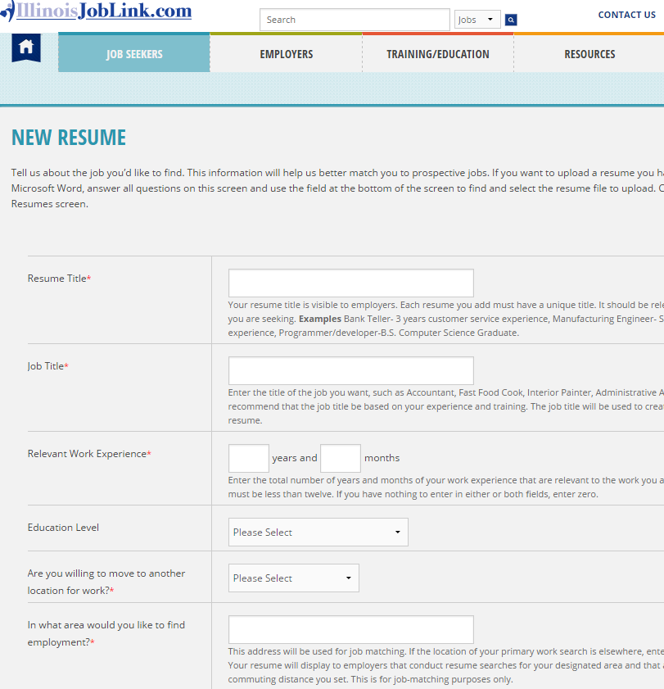
Illinois JobLink - Resume
You must create or upload at least one resume.
Upload/create multiple resumes for different types of positions you’re seeking!
Enter job title for position you’re seeking

Slide 41


Searching for a Job!
You must be:
Able
Available
Actively searching for work to receive unemployment insurance benefits.

Slide 42

Search for Jobs
Click to view entire posting.

Slide 43
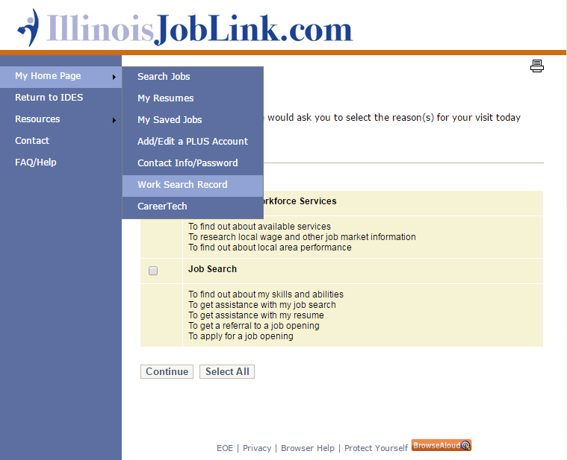

View your Illinois JobLink work search record

Slide 44
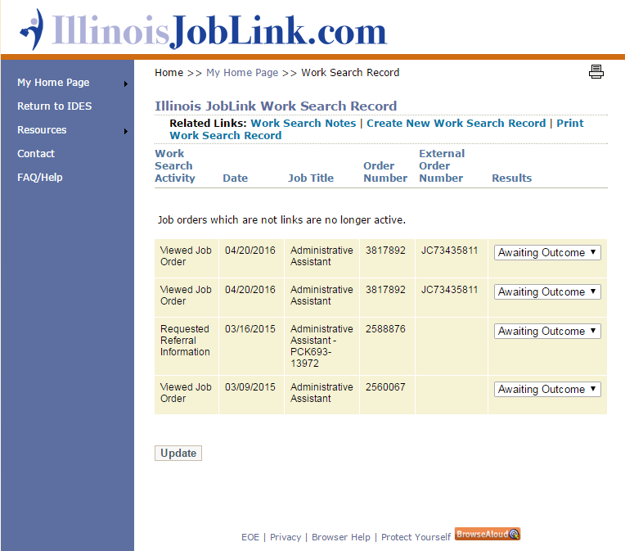
Illinois JobLink work searches are autogenerated

Slide 45
Record work search activity for jobs outside of Illinois JobLink
Click Here

Slide 46
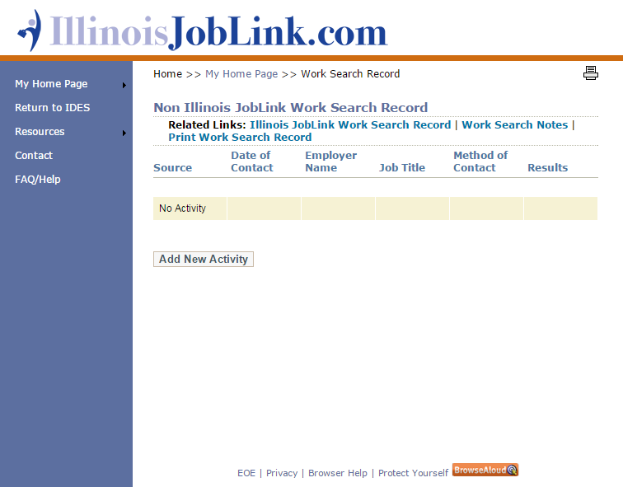
Click Here

Slide 47



Record
your work search activity for jobs outside of Illinois JobLink
Notes:
Tell audience to pull out the creating a work search handout. Use handout to explain.

Slide 48


Notes:
Tell audience to pull out the creating a work search handout. Use handout to explain.

Slide 49
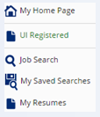

How do I know my registration is complete?
Verify UI Registered
is GREEN
.

Slide 50
Questions?
workNet DuPage Career Center – Lisle
Susi Pihera
630-955-2041 or spihera@worknetdupage.org
www.worknetdupage.org
Illinois Department of Employment Security
2 Smoke Tree Plaza, North Aurora, IL 60542
Call Center: 1-800-244-5631
Access DuPage -DuPage County Health Department
Robin Lavender 630-221-7049 or robin.lavender@dupagehealth.org
U.S. DOL Employee Benefits Security Administration
1-866-444-3272 or www.askebsa.dol

